Slide 1

TRAFFIC SIGN CLASSIFICATION USING CNN
-Anjali K B

Slide 2

INTRODUCTION
In today’s world, identification of traffic signs has become an
Important aspect of our lives. Looking at the increasing traffic,
To ensure safety of all and for automatic driving in future, traffic
Sign classification is utmost necessary.
Traffic Sign, indeed ,provide us a multitude of information and guide
Us accordingly so that we can move safely. Traffic Sign Classification is
very useful in Automatic Driver Systems.
In this project I am using a CNN model for Traffic sign classification.
A convolutional neural network is a class of deep learning networks, used
To examine and check visual imagery. It is used to train the image
Classification and recognition model because of its high accuracy and
precision

Slide 3
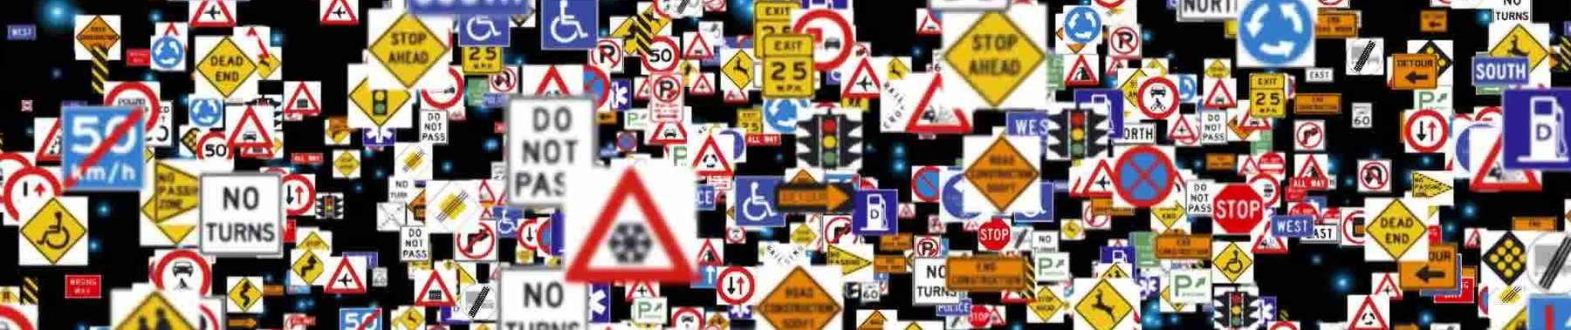
DATASET USED
GSTRB-GERMAN TRAFFIC SIGN RECOGNITION BENCHMARK
Multi-class, single-image classification Problem
43 Classes
More than 50,000 images in total

Slide 4
STEPS FOLLOWED
Importing Necessary Libraries
Preprocess the image
Load Data and Labels
Assigning Path for Data Set
Store Data, Labels in list
Convert List into numpy array
One-hot encoding of labels
Building the model
Compiling the model
Fitting the model
Plotting Accuracy and Loss Values
Showing the Prediction

Slide 5
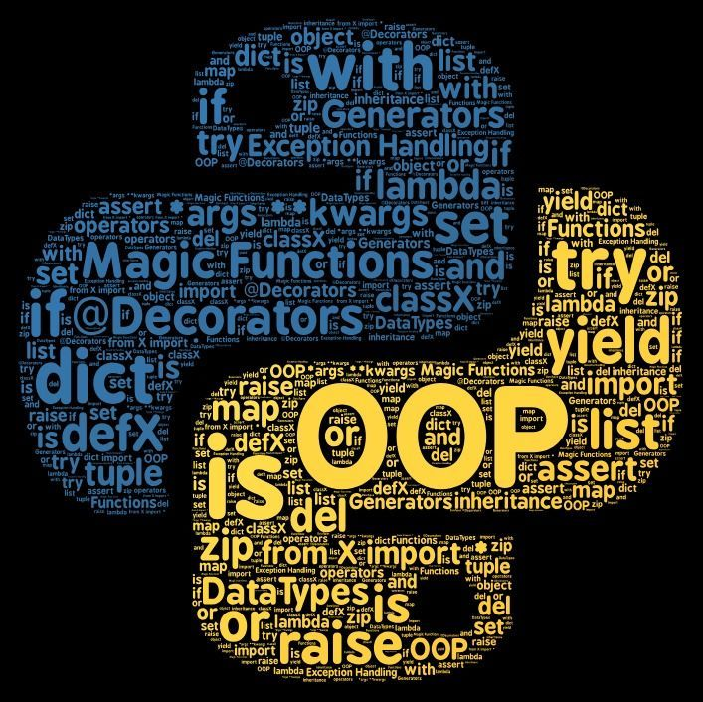
IMPORTED LIBRARIES
Numpy
Pandas
Keras.Models
Matplotlib
Cv2 for image processing
Python image Library(PIL)
Sklearn for train-test split
Keras.Utils for Categorical
Keras.Layers

Slide 6
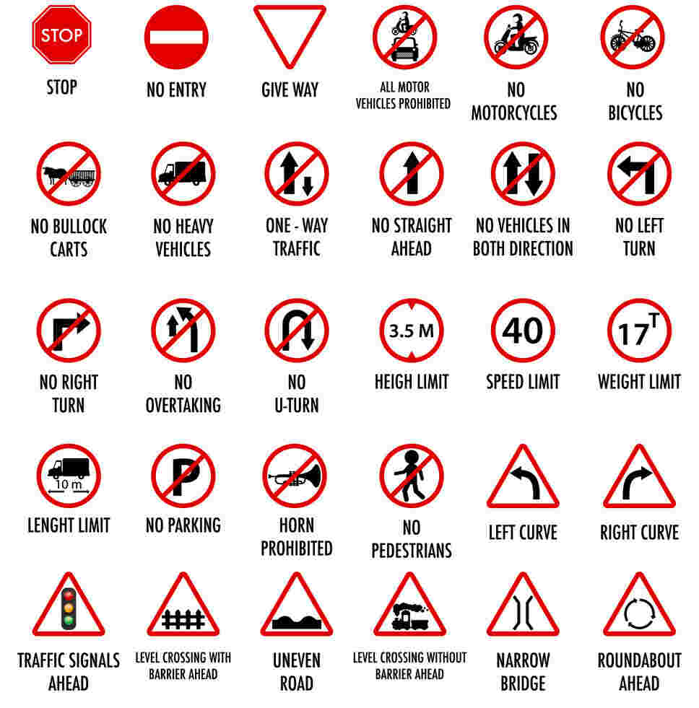
Preprocessing of Image
Using For Loop
Iterates over each and every image
Opens every image
Resize into (30,30)
Converts image into array
Appending values into data and Labels

Slide 7
One-hot encoding
One-hot encoding is a technique that we use to represent categorical variables as-
Numerical values
It allows the use of categorical variables in models that require numerical input
It can improve model performance by providing more information to the model about
The categorical variable
It can help to avoid the problem of ordinality , which can occur when a categorical variable
Has a natural ordering

Slide 8
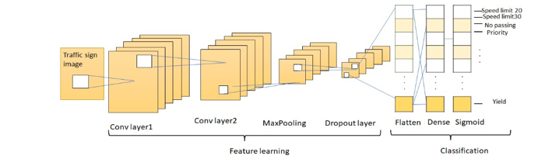
Building the Model
CNN-CONVOLUTIONAL NUERAL NETWORK
CNN contains multiple convolutional layers which are responsible for the extraction of
Important features
The earlier layers are responsible for low-level details and the later layers are responsible
for more high-level features
The Convolutional operation uses a custom matrix, also called filters to convolute over the
input image and produce maps. These filters are initialized randomly and then are updated
via backpropagation

Slide 9
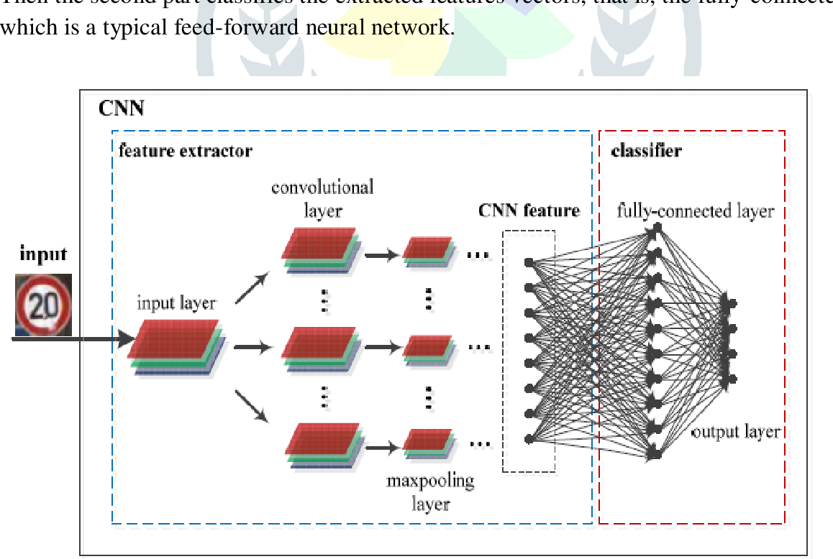
Convolutional neural network contains a three-dimensional arrangement of nuerons
instead of the standard two-dimensional array. The first layer is called a convolutional
layer
Each neuron in the convolutional layer only processes the information from a small part
of the visual field. Input features are taken in batch-wise like filter. The network
understands the images in parts and can compute these operations multiple times to
complete the full image processing
Processing involves the conversion of the image from RGB or HSI scale to grey scale.
The changes in the pixel value will help to detect the edges and images can be classified
into different categories
Propagating is uni-directional where CNN contains one or more convolutional layers
followed by pooling and bidirectional where the output of the convolutional layer goes
to a fully connected neural network for classifying the images

Slide 10
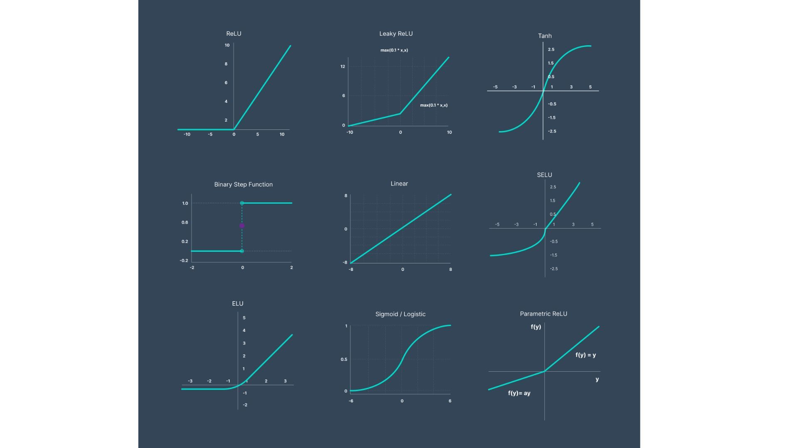
Activation Function
An activation function decides whether a nueron should be activated or not. This means
that it will decide whether the neuron’s input to the network is important or not in the
process of prediction using simpler mathematical operations.

Slide 11
ReLu Function
A Rectified linear unit (ReLu) is an activation function that introduces the property of
nonlinearity to a deep learning model and solves the vanishing gradients issue. It is one
of the most popular activation functions in deep learning. The function returns 0 if it
receives any negative input, but for any positive value x it returns that value back.
Softmax Function
Softmax allows CNNs to output a probability over the possible classes. This is important
because it allows the CNN to make more accurate predictions. Softmax works by first
normalizing the input vector so that all of the numbers in the vector sum to 1. Then, it
exponentiates each number in the vector and divides by the sum of all of the exponentia-
ted numbers. This results in a vector of probabilities ,where each probability is between 0
and 1 and represents the probability that the input image belongs to a particular class. The
probability distribution output by the softmax function can then be used to make a more
accurate prediction about the class of an input image.

Slide 12
Compiling the Model
Model compilation is an activity performed after writing the statements in a model and
Before training starts. It checks for format errors, and defines the loss function, the
optimizer or learning rate, and the metrics. A compiled model is needed for training but not
necessary for predicting.
Fitting the Model
I have taken epochs =20
Using 20 epochs I got a satisfying accuracy

Slide 13
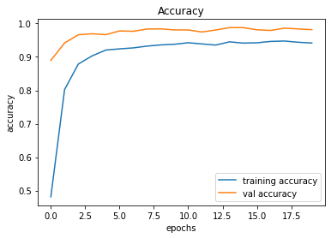
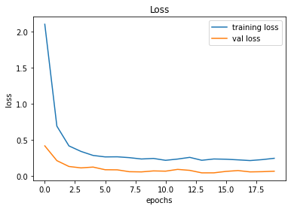
Plotting Accuracy and Loss Values
Accuracy
Loss
Accuracy , loss, val accuracy are all clear concepts. With an accuracy of about 0.94, it classifies
The photos. The accuracy and loss of the model are then determined by plotting the graph,
and the outcomes are positive

Slide 14
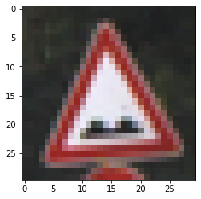
Prediction
Predicted traffic sign is: Bumpy road

Slide 15
Conclusion
The model does the classification quite accurately on the GTSRB dataset . The final
Accuracy Is 94% and validation accuracy is 98% with minimal loss. The model demonstrated
good generalization on the test set, achieving satisfactory accuracy of 95.40%.After building
a useful CNN model and properly preparing the training dataset, it gets accurate
classification results and also generates results with good accuracy.

Slide 16
Thank You

